Slide 1
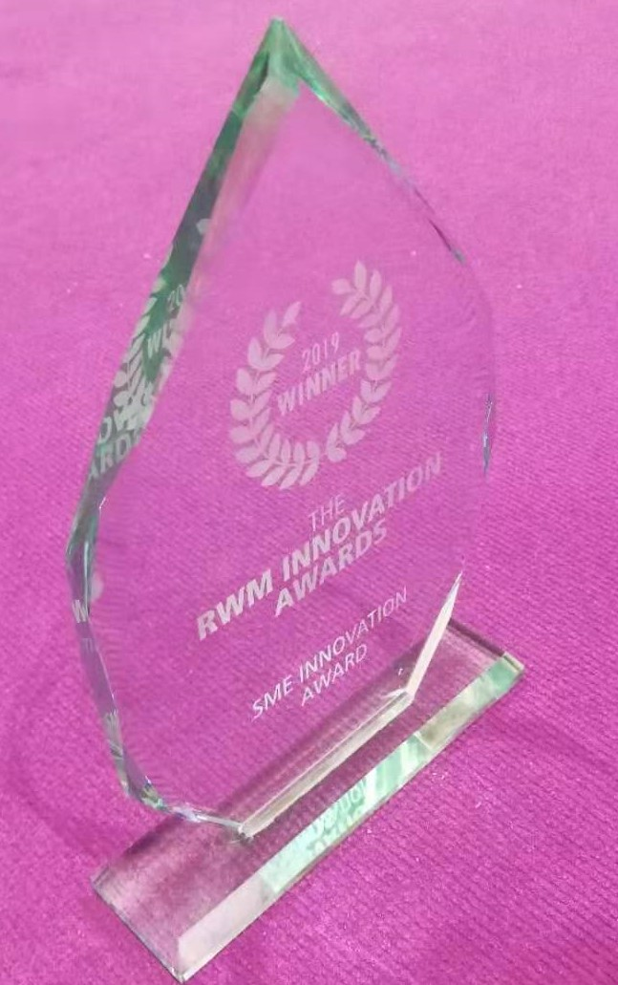

ADVANCED BIOMATERIALS
Products and Logistics
Background June 2020

Slide 2
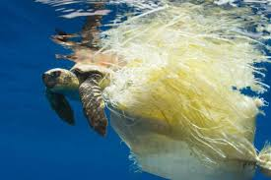
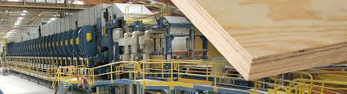
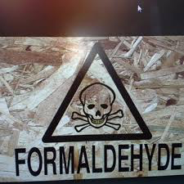

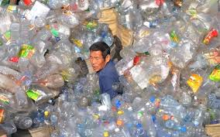
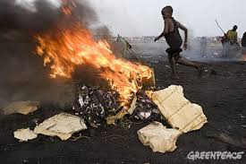
WORLD PROBLEMS- MATERIALS
EU woodpanel market €45Bn - >100 Companies
EU Plastics market €350Bn >60,000 Companies

Slide 3

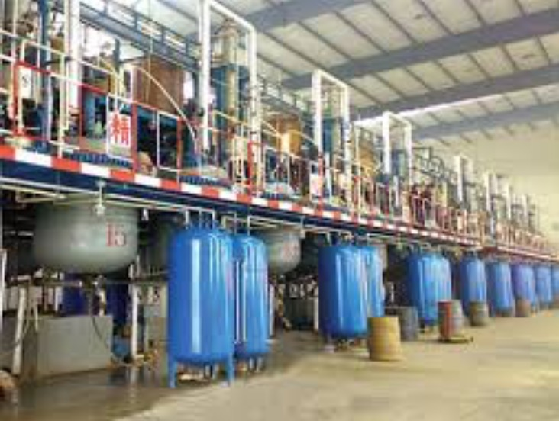
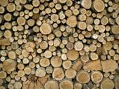

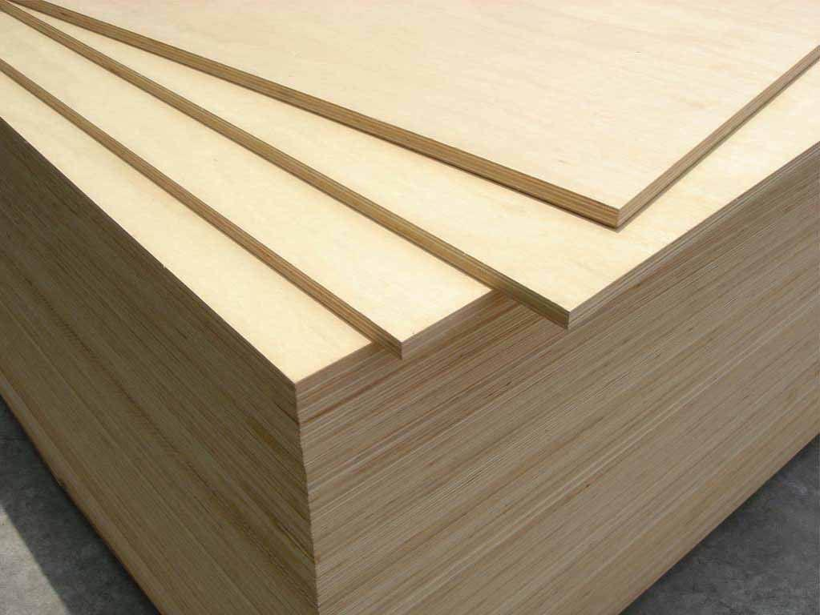
Wood Panel Industry – Global Scale and Problems
Oil Based Toxic
Urea/Phenol/Formaldehyde
Adhesives
$25BN
$350BN
Plywood, OSB, MDF for construction, furniture etc. ETC

Slide 4
DDGS – Cambond Resin Feedstock
Cambond resin is made from DDGS – Distillers Dried Grains and Solubles
Dried residue after the starch fraction of corn/wheat/barley is fermented to produce ethanol and carbon dioxide. ... DDGS is the predominant by-product and is used as animal feed.
Existing U.S. ethanol plants can produce > 60M Tonnes of DDGS.
UK produces more than 1.5M Tonnes a year.
As bioethanol production increases so does DDGS
DDGS is a global commodity available everywhere

Slide 5
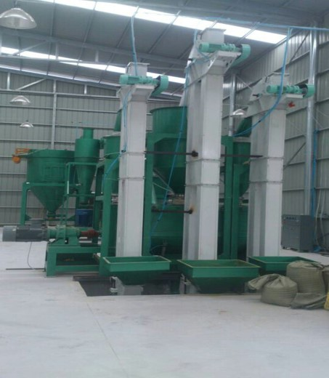
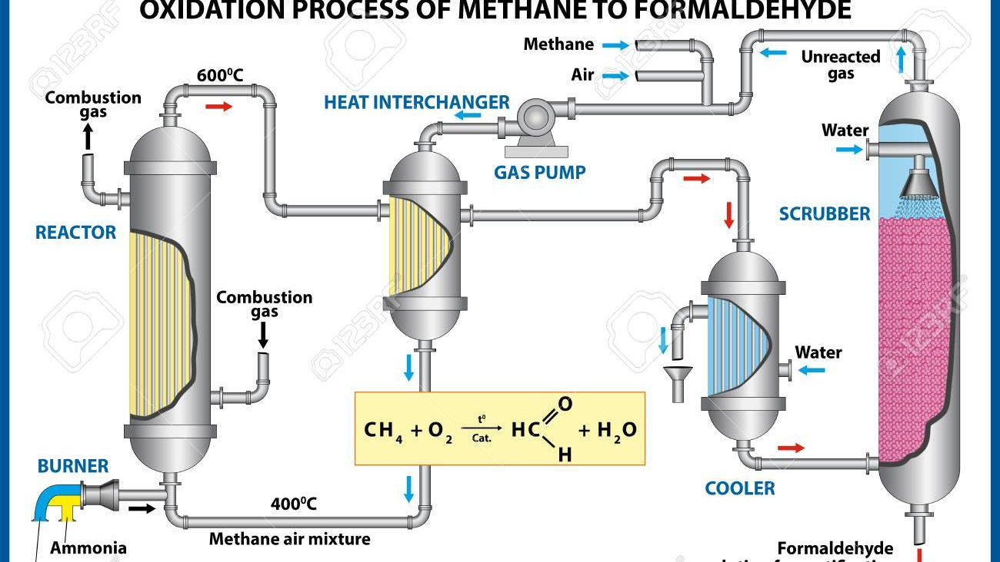
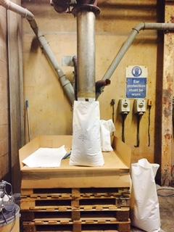
Formaldehyde vs Cambond
Food Grade
Non-toxic
40%CO_{2e}
Toxic
High Energy
Regulated

Slide 6

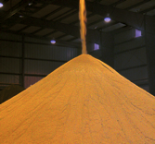
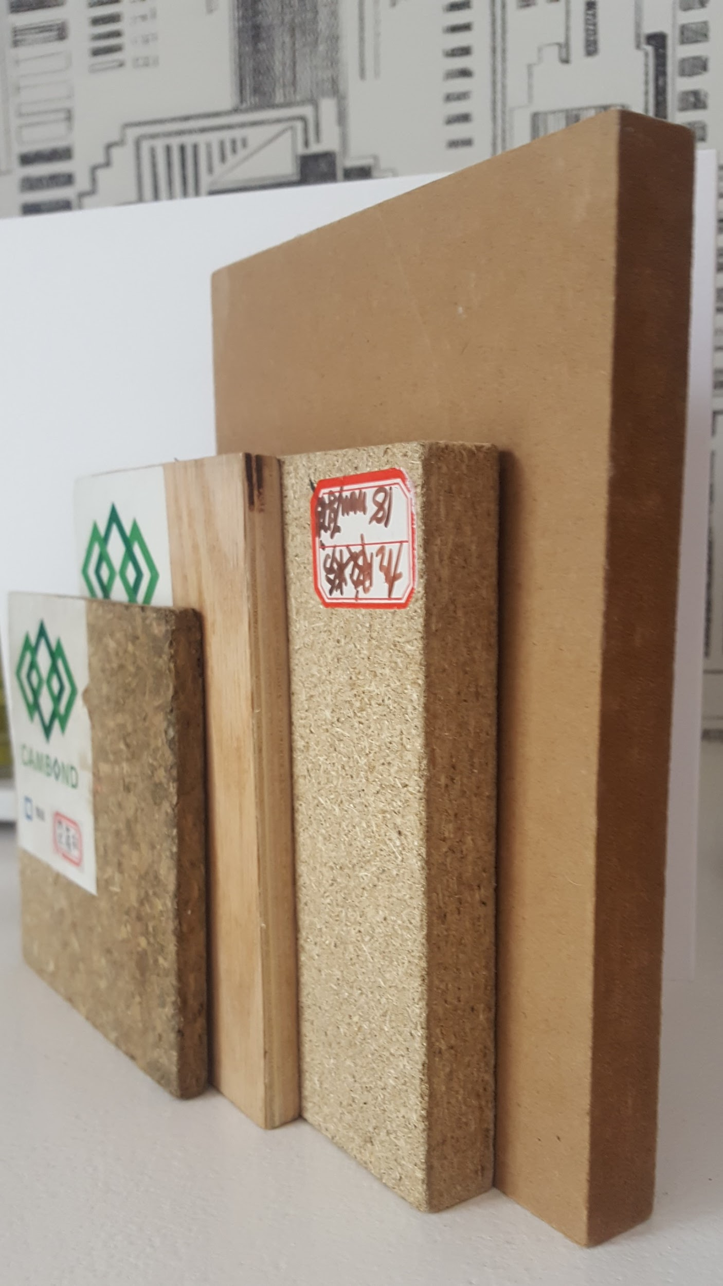
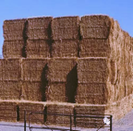
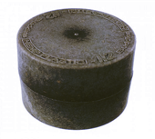

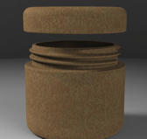
CAMBOND INNOVATION AND SUPPLY CHAIN
REED
DDGS
WOOD PANELS
STRAW
MOULDED PRODUCTS
CAMBOND
RESIN MAKES A RANGE OF BIO-COMPOSITES
PALM OIL
WASTE
BIOPLASTIC
PRODUCTS

Slide 7
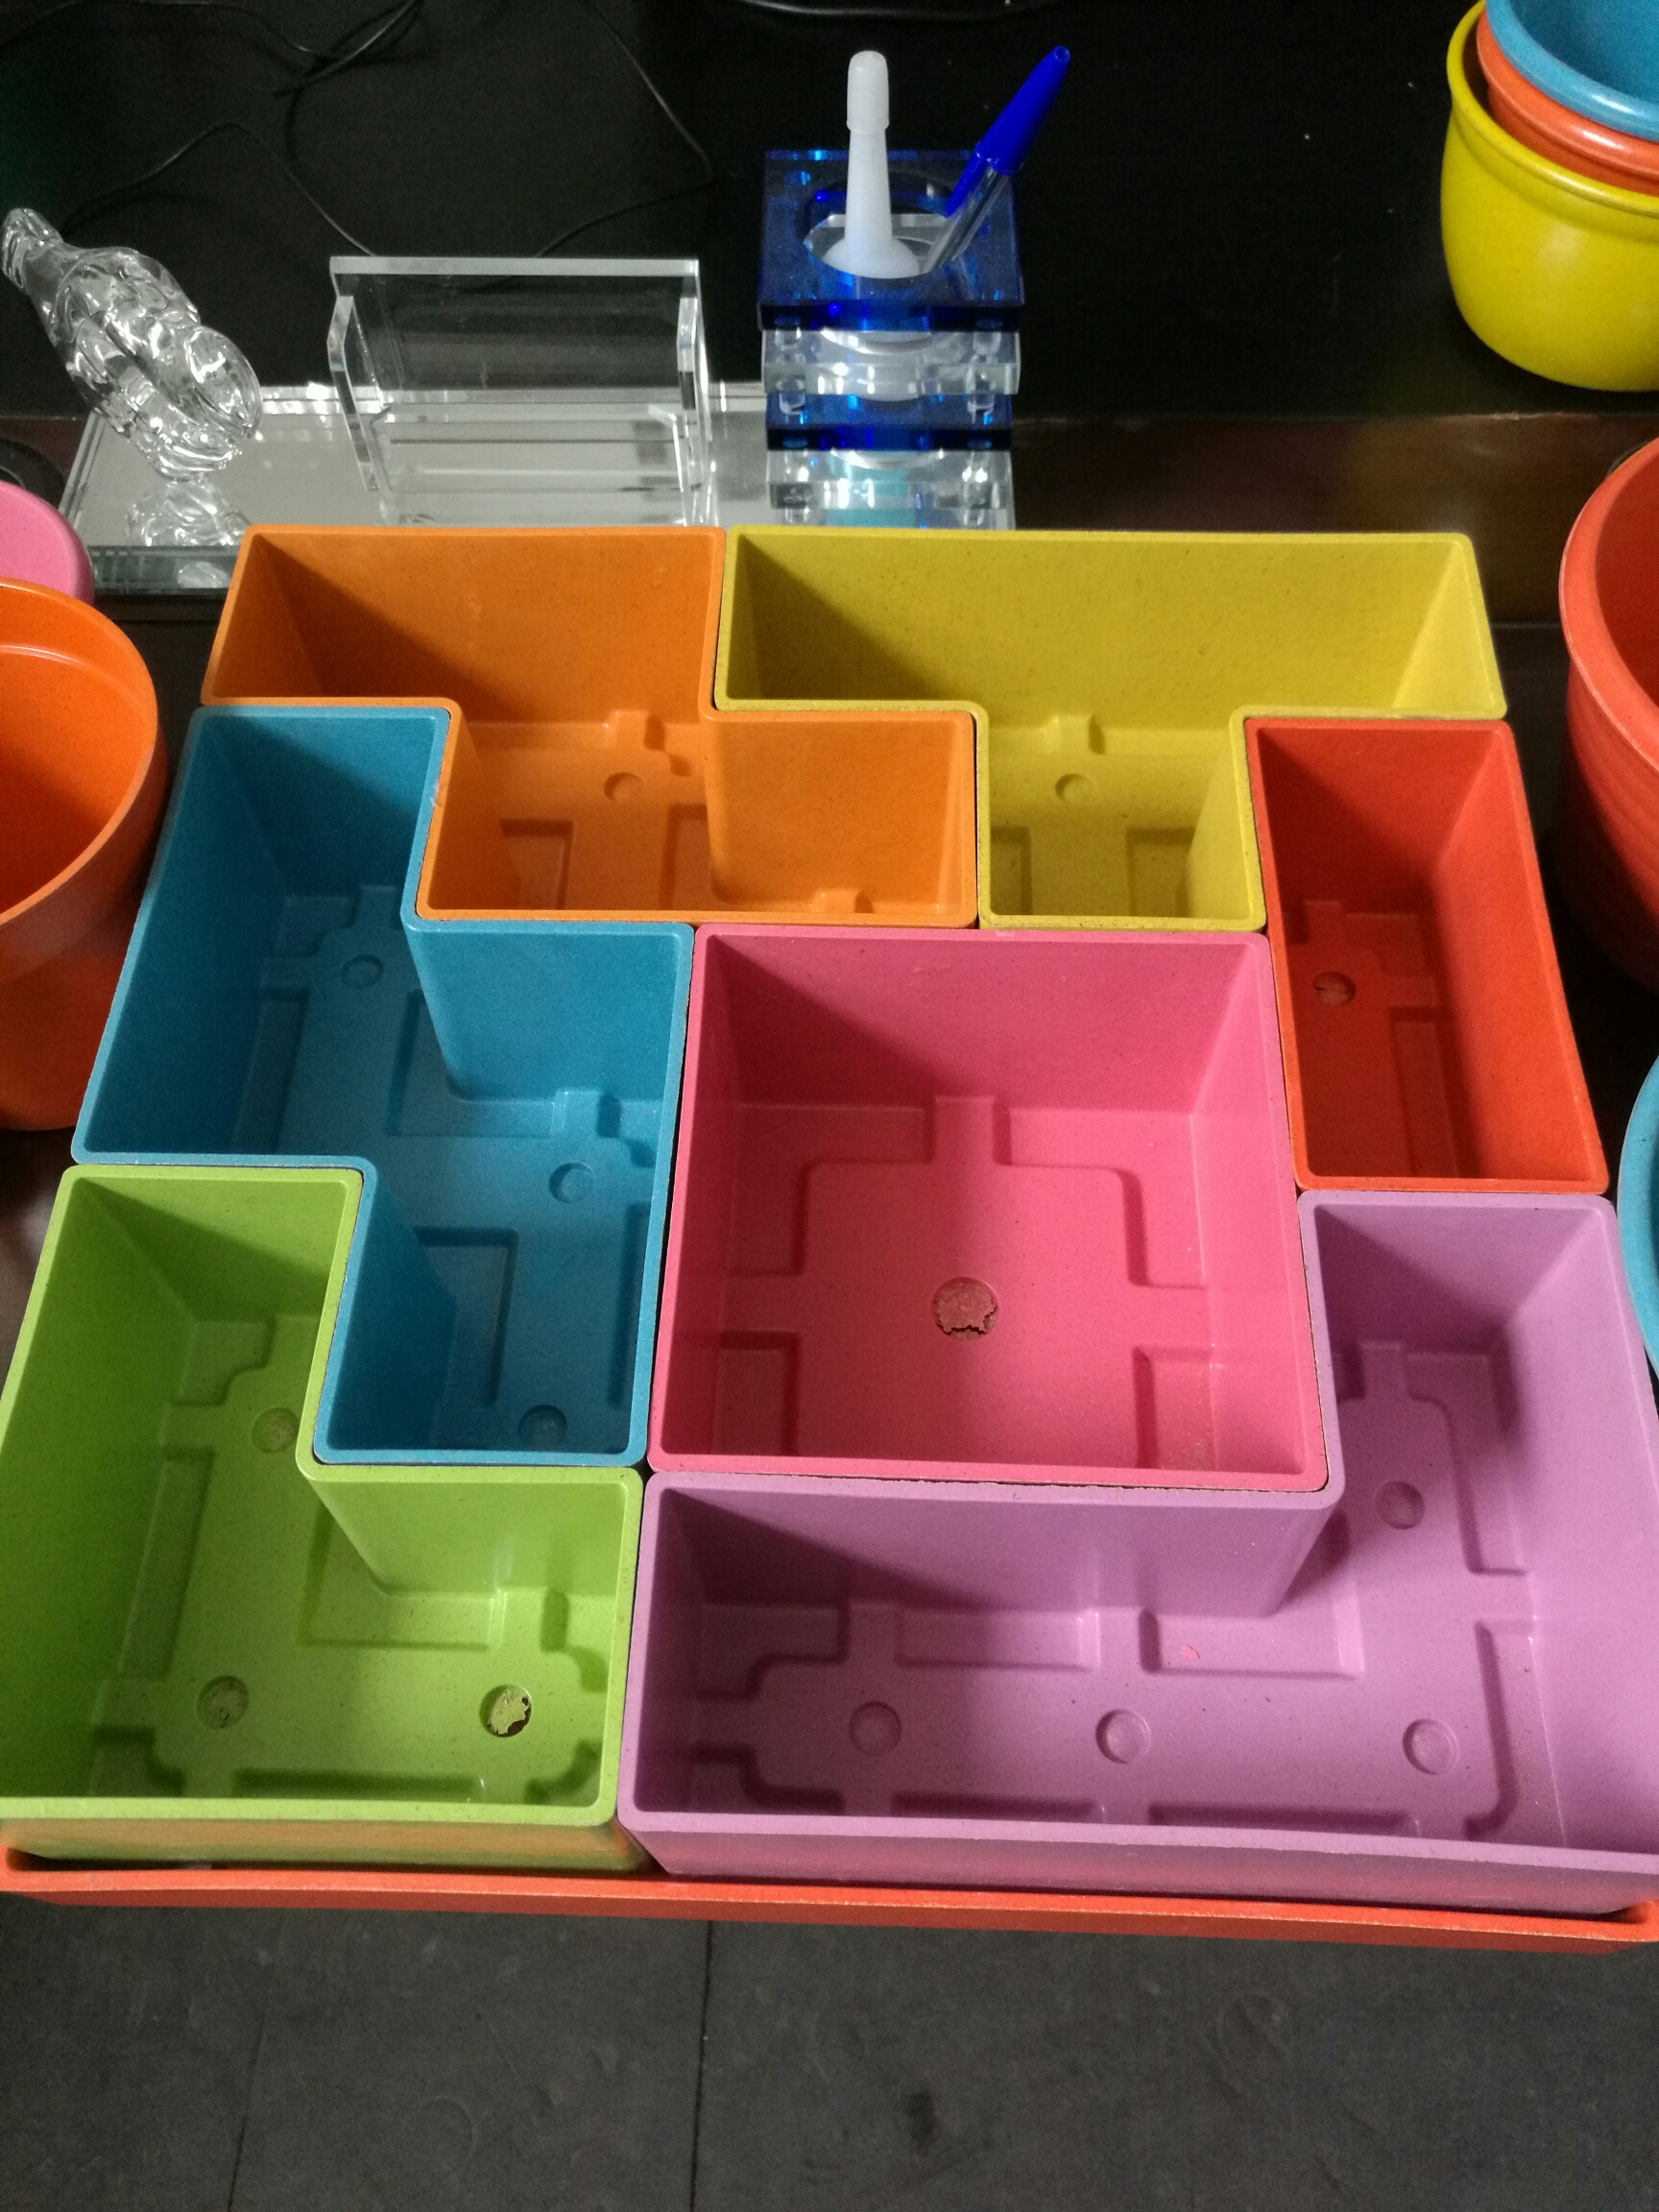
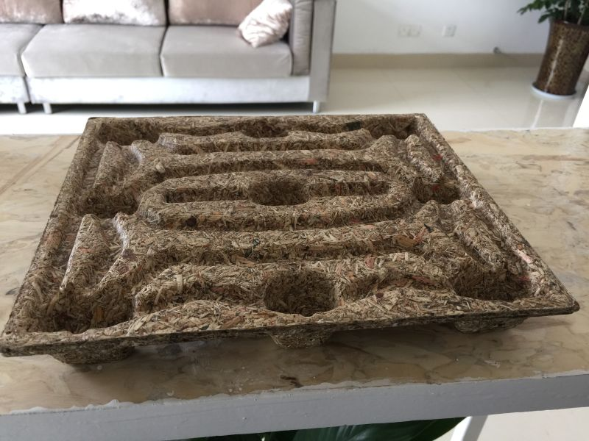
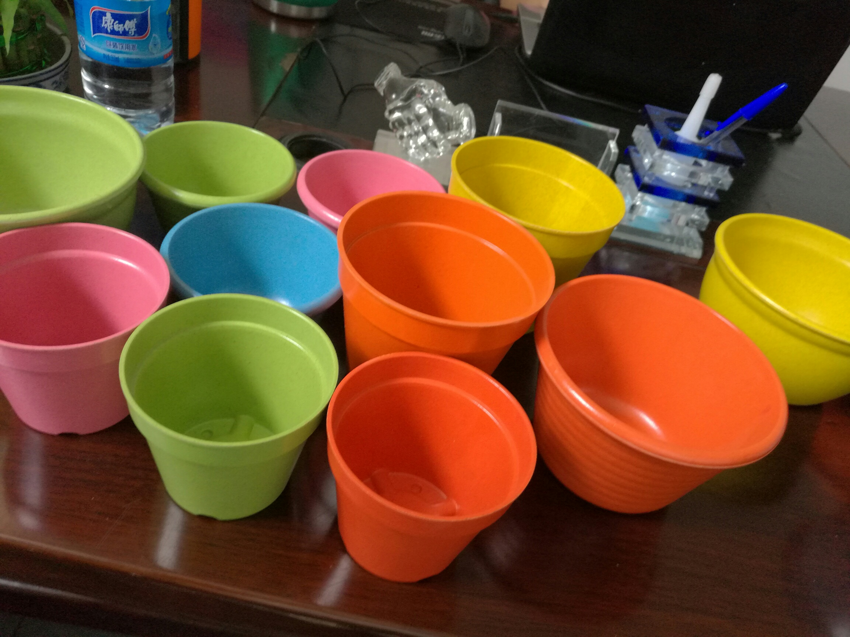
A New Generation of Green Products
Resin can be used to combine biomass with polymers and other materials for ‘greener’ plastics.
Reduces plastic in many products
New generation * Carbon – ve biomass products

Slide 8
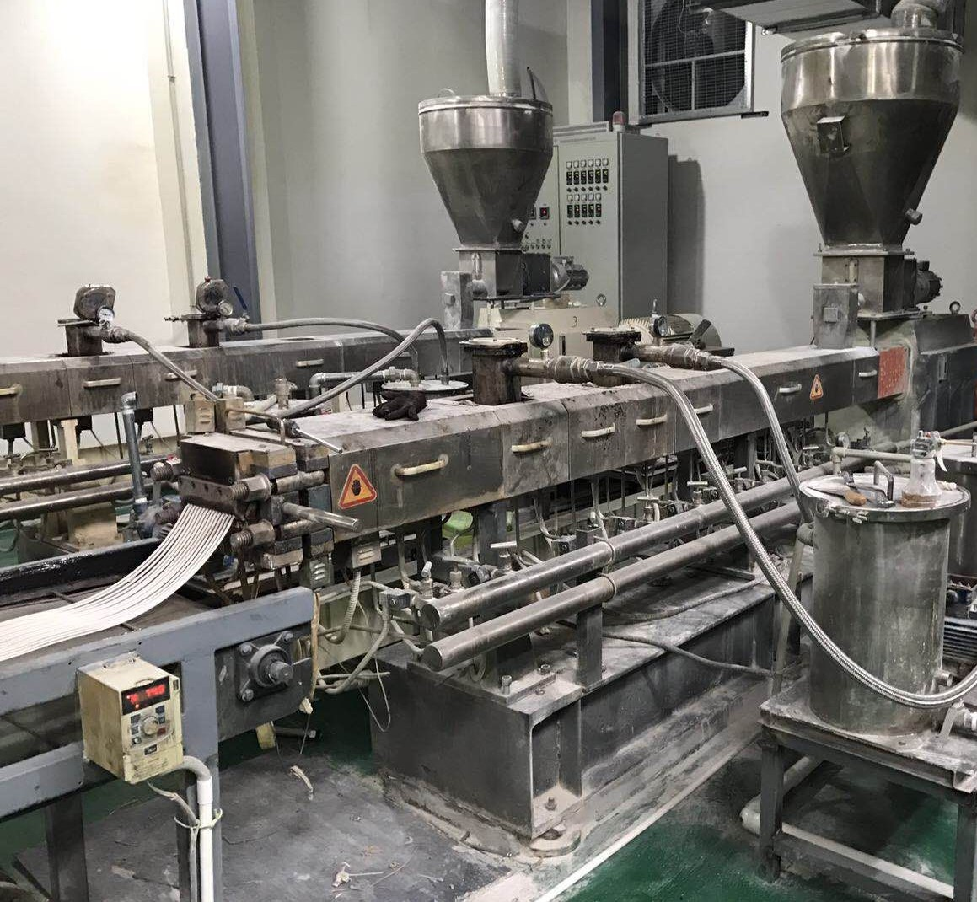
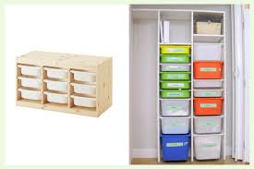
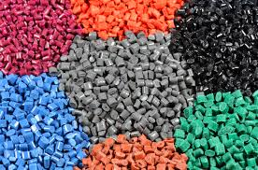

CAMBOND INNOVATION -
REED
DDGS
BIOMASS
ALGAE
Biomass/polymer composites
Low carbon
Low cost
EXISTING SUPPLY CHAIN

Slide 9
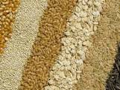

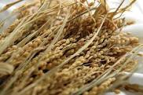
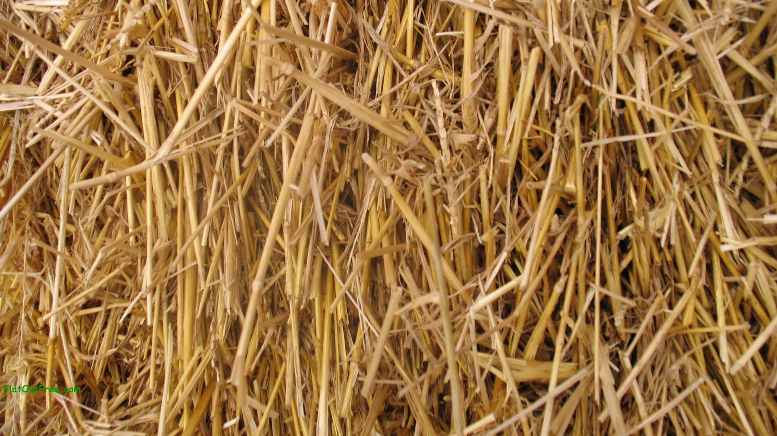

CIRCULAR ECONOMY POSSIBILITIES
Agriculture produces >2Billion tonnes waste biomass.
More than 50M tonnes of plastic waste in EU.
Could the existing supply chains use these to manufacture sustainable products?

Slide 10

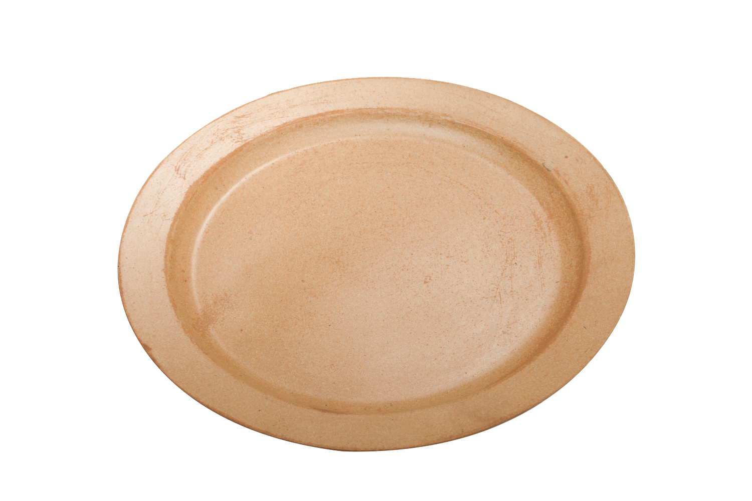
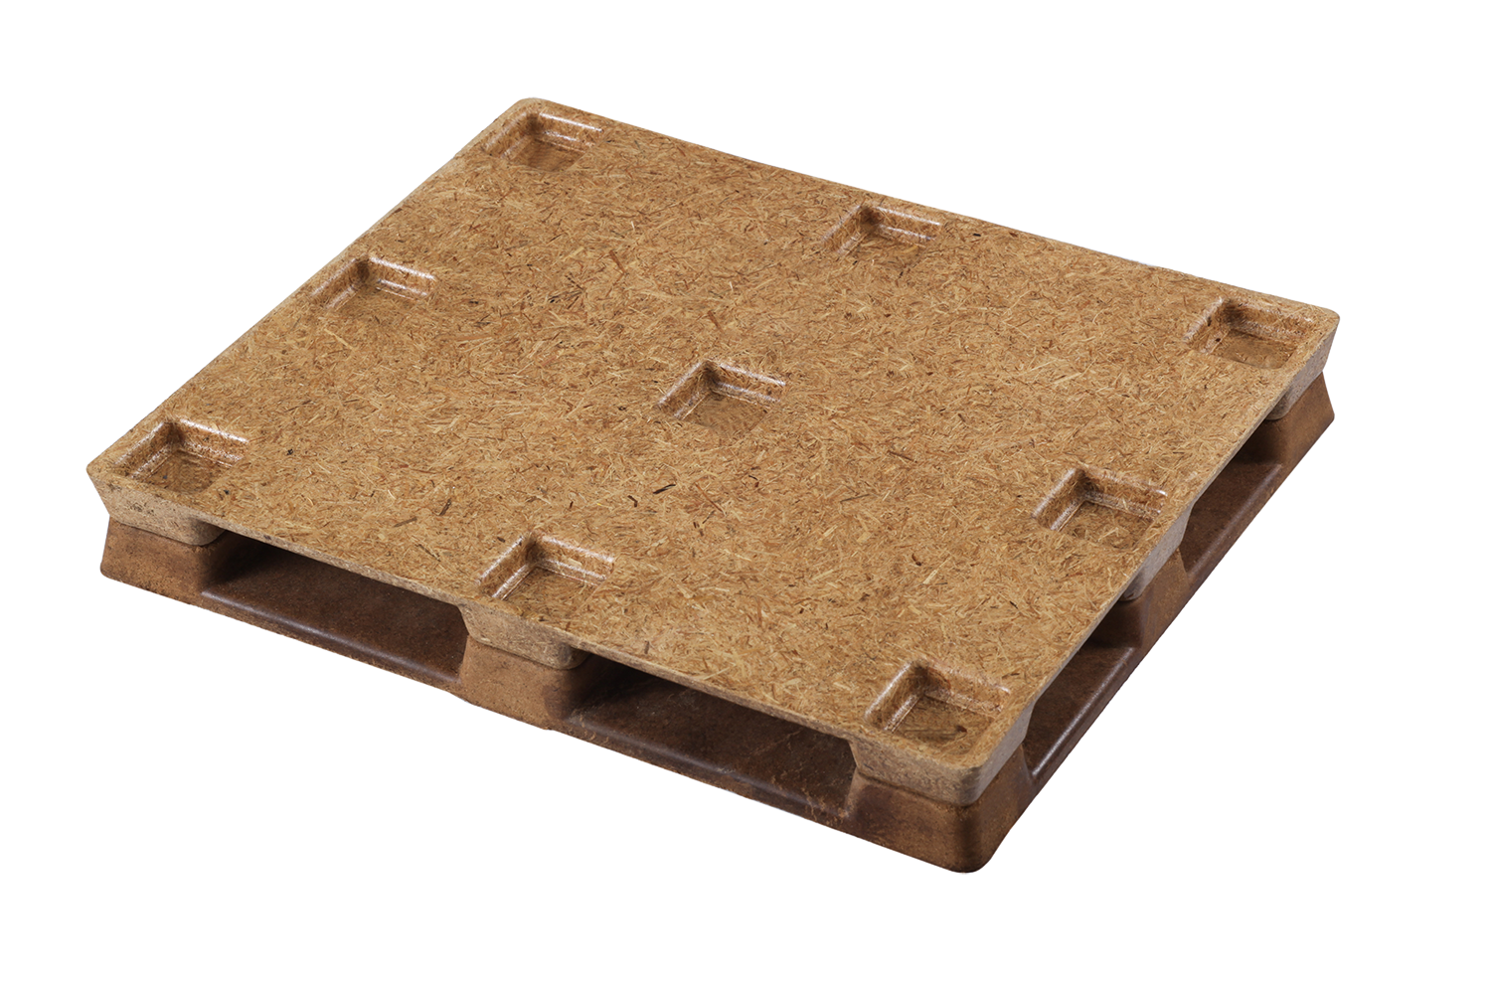
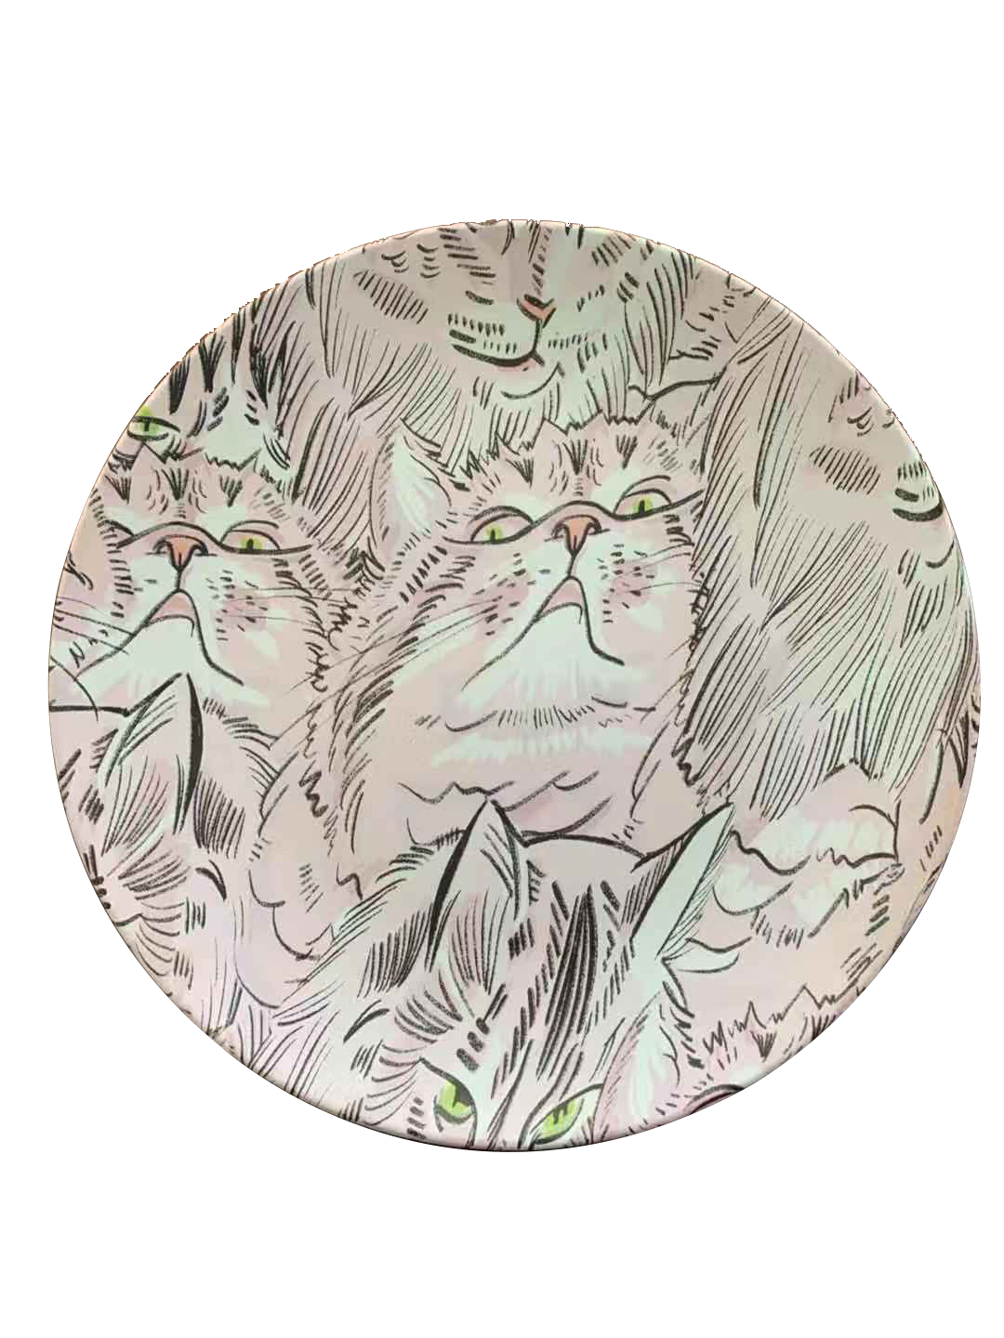
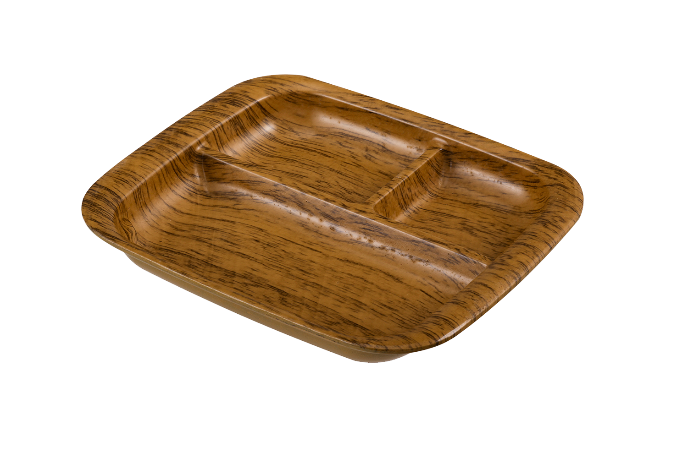
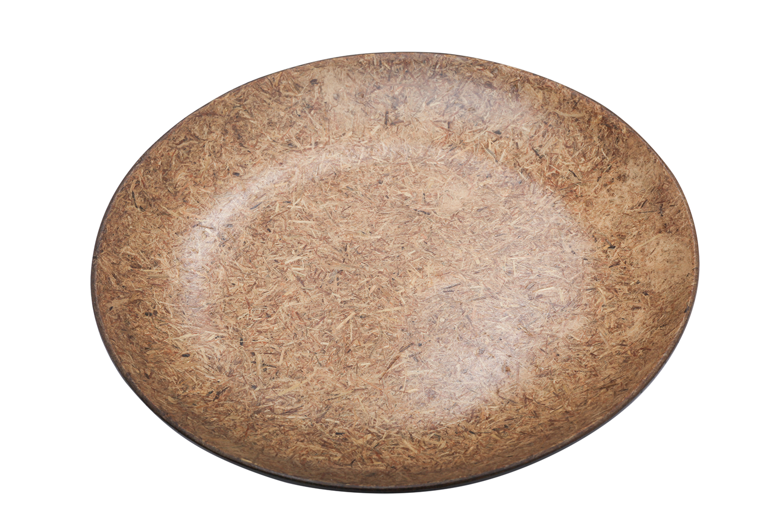
Planet Friendly Products
Wheat Straw Pallet
Rice Husk Bowl
Bamboo Single Use Plate
Palm Fibre Plate
Reed Fibre Plate
Bamboo Fibre Plate

Slide 11

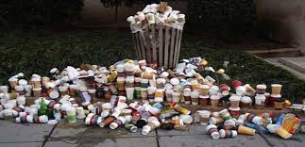

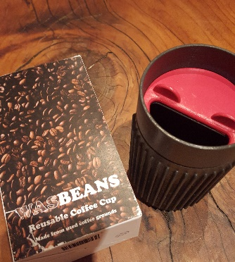
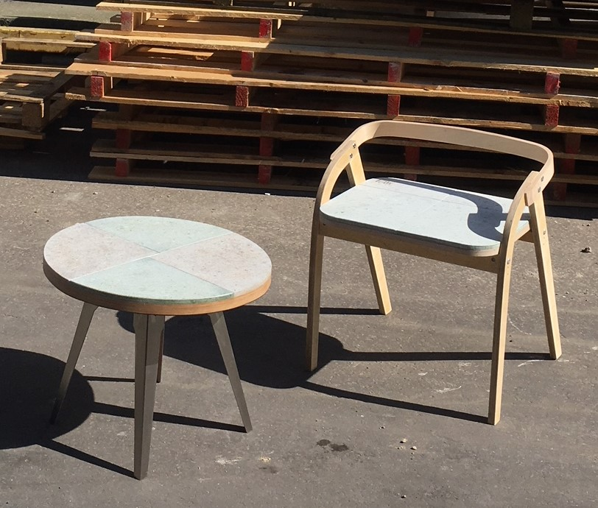
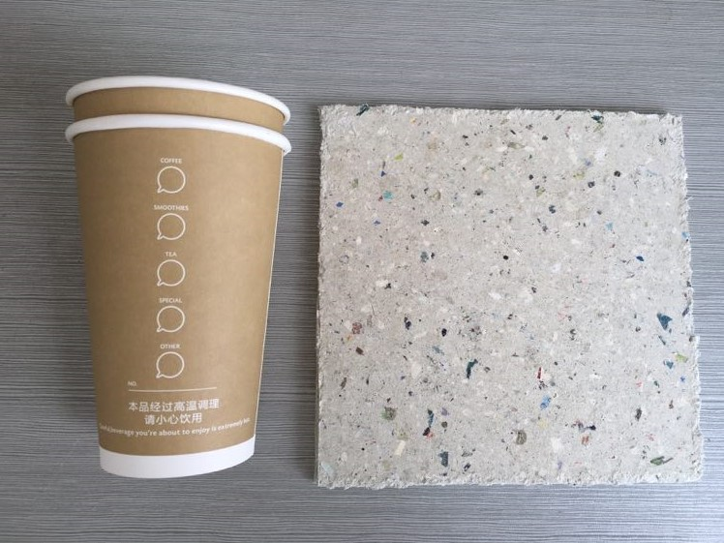
CAMBOND SOLUTIONS – COFFEE RETAIL
Wasbeans cup https://www.youtube.com/watch?v=1OWjh1tIMNE

Slide 12
COMMERCIALISATION – VALUE PROPOSITION
Cambond technology
Better use of waste streams
Cleaner environmentally friendly manufacturing
Reduce COST of manufacturing feedstocks
Low toxic chemicals, solve environmental
Carbon footprint (<40%)
Cambond technology reduces carbon helps clean environment.

Slide 13
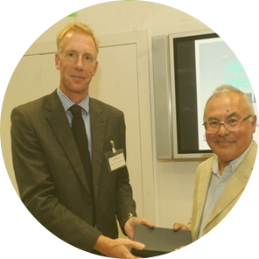


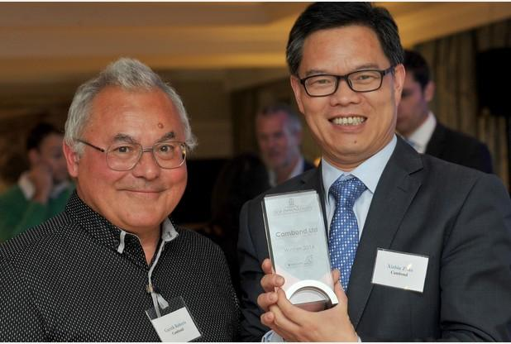

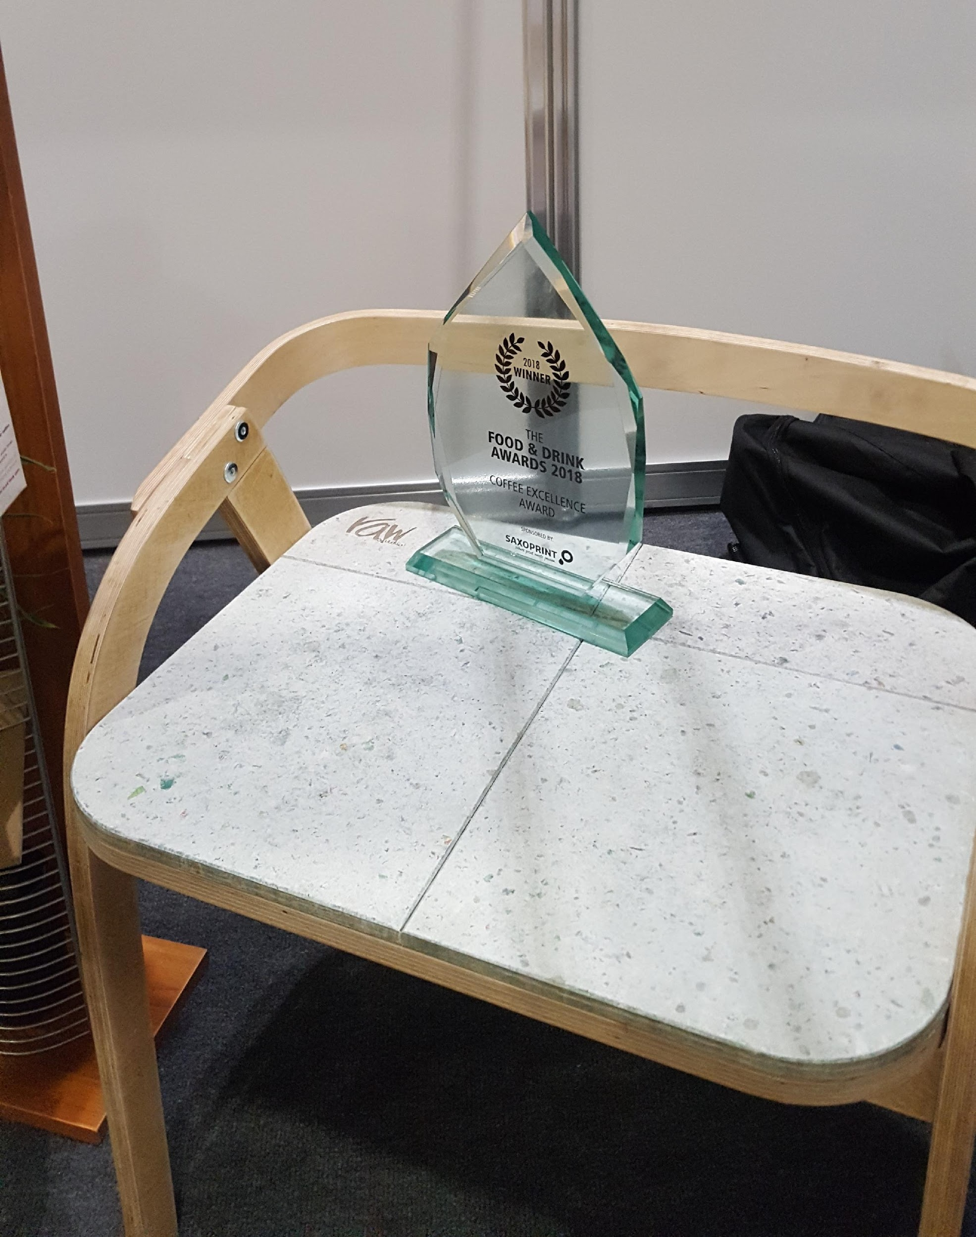
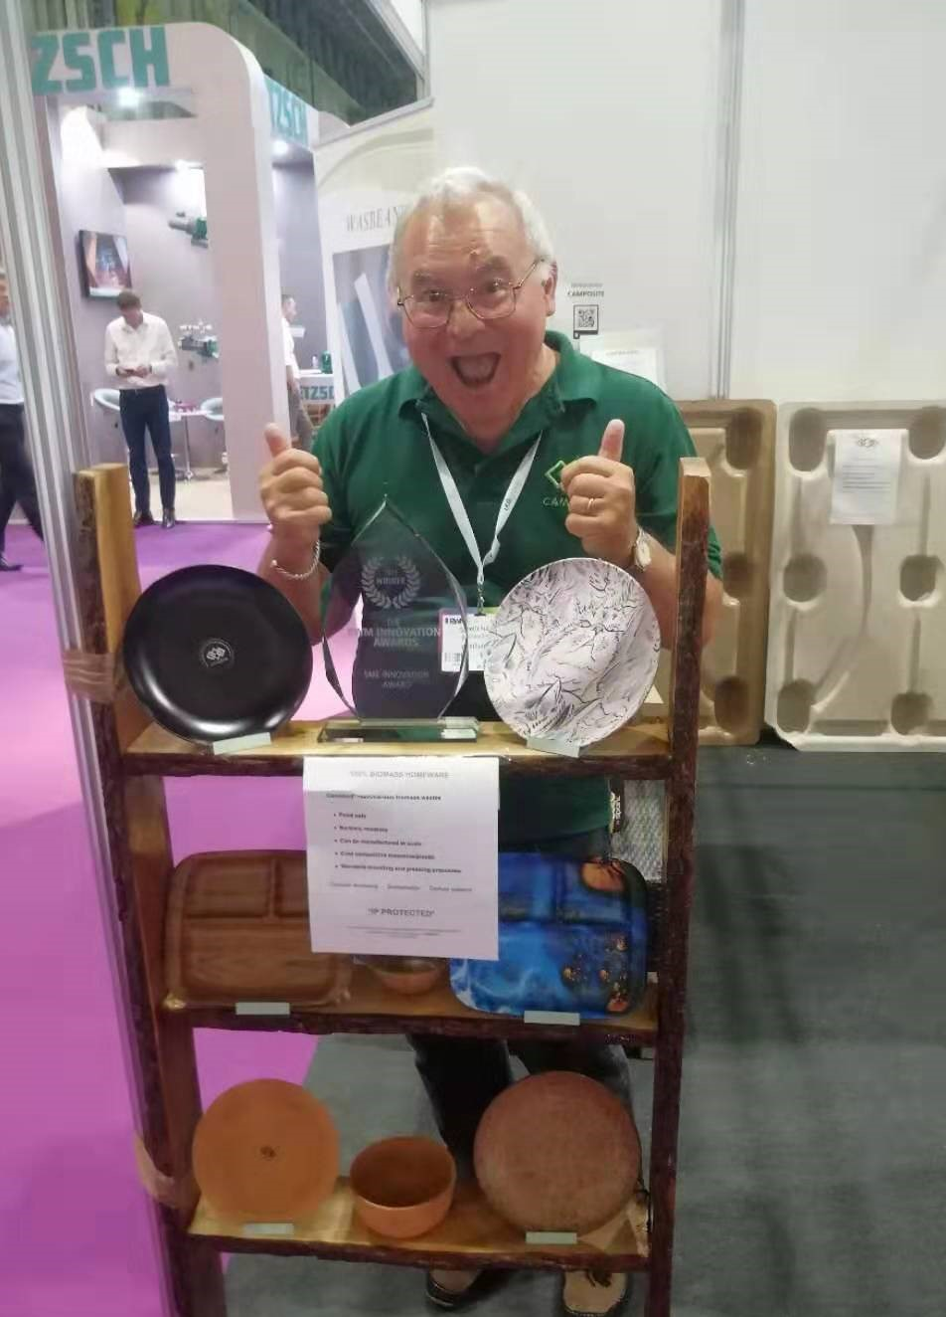

CAMBOND
Dr. G Roberts
2014 Top Innovations Awards
Shell Springboard
2018
Prof. X Zhao
2014 Royal Society of Chemistry Emerging Technology Business
Coffee Excellence 2018
Design Council 2017

Slide 14


www.cambond.co.uk
Address: Future Business Centre, Cambridge CB4 2HR
Tel: 44- 01223 911505
Mobile: 44 -7507949517
Email: xzhao@cambond.co.uk
groberts@cambond.co.uk
cambond@xiaobinzhao1

